Slide 1

Direct To Home Customer Churn Prediction Study Final Submission
Charles Kilpatrick
September 15, 2023

Slide 2
Executive Summary
Key Takeaways:
Accounts with a complaint in the last year are 2.91 times more likely to churn than accounts with no complaint.
Accounts with a tenure of 6 months or less account for 81.28% of churn.
The complaint frequency for accounts which churned with a tenure of 6 months or less is 54.60% and median customer care contact is 17.
For accounts which churned within 6 months the proportion of Regular Plus accounts is 66.47%.
Single status accounts are 2.34 times more likely to churn than married status.
Females and Tier 2 cities are underrepresented in the customer base.

Slide 3
Executive Summary (continued)
Key Next Steps:
Complete root cause analyses of account complaints, track complaint resolution metrics and implement learnings to improve customer care agent scores.
Perform a study of the account onboarding process to better understand why 81.28% of the total churn occurs for accounts with tenure less than 6 months.
Complete a study to determine why 27.33% of Regular Plus accounts churn as compared to the 16.84% churn rate for the overall population.
Implement a study to determine why accounts with the primary account holder being of single marital status are 2.34 times more likely to churn than accounts with a primary customer of married status.
Investigate shifting advertising to target females and Tier 2 cities.

Slide 4
Problem and Solution Summary
Problem That Is Being Solved:
This study addresses the issue of account churn for a direct to home provider that is facing significant competition and is challenged to retain accounts. Account churn negatively impacts the provider’s market position and revenue. Account retention is critical for business sustainability as many accounts service multiple customers.
Most of the account churn occurs within 6 months of accounts being established and the majority of the short tenure accounts have contacted customer service frequently and have registered a complaint. There is correlation between account complaints, customer care agent score and churn.
There are significant concerns with churn for the Regular Plus account segment and for accounts where the primary customer is of single marital status.

Slide 5
Problem and Solution Summary (Continued)
Key Points Describing the Final Proposed Solution Design:
Improve onboarding process and customer care agent scores for accounts, particularly those with a tenure of less than 6 months. Account complaints are closely linked to churn.
Mitigate factors causing Regular Plus accounts to churn more frequently.
Modify account terms to achieve better retention of single customers.
Issue loyalty reward coupons for accounts with tenure greater than 6 months rather than giving payment coupons to new customers.
Adjust advertising to target females, and Tier 2 cities.
Consider enhanced cashback for enrollment in automated payment.

Slide 6
Problem and Solution Summary (Continued)
Assessment of the Proposed Solution Viability for Problem Resolution:
Most churn is in the first 6 months. Improving customer care agent scores and rewarding customer loyalty after six months tenure will reduce churn.
Reducing Regular Plus churn to a comparable level will significantly reduce churn.
Understanding and addressing causes for greater churn for accounts with single status primary customer is a viable path forward.
Improving customer care agent scores reduces complaints and the resulting churn.
Shifting advertising to targeting females and Tier 2 cities is easily achievable.
Implementing increased cashback for automated payments is easily achievable.

Slide 7
Recommendations For Implementation
Key Actionable Insights and Expected Costs/Benefits:
The net cost of giving an increased cashback loyalty reward for accounts with tenure greater than 6 months rather than payment coupons for new customers is zero.
The cost of improving the onboarding process and customer care agent scores will be offset by reduced customer care costs later.
If changing Regular Plus terms are a significant cost, then new customers can be steered to the Regular, Super, or Super Plus account segments with small cost.
Consider increased cashback for accounts enrolling in automated payment as automated payments reduce churn. Cost control will be important for this measure.
Shifting existing advertising funds to target females and Tier 2 cities will have zero net cost impact.

Slide 8
Recommendations For Implementation (Continued)
Key Risks and Challenges:
Customers may push back on shifting from new account payment coupons to loyalty rewards such as enhanced cashback for accounts with tenure greater than 6 months.
The Regular Plus account segment accounts for 34.34% of monthly income. This is greater than either Regular or Super Plus and only slightly less than Super. Care should be taken to ensure any decrease in Regular Plus subscriptions is fully offset by increases in other account segments.
Shifting advertising to target females and Tier 2 city customers may reduce other sales.

Slide 9
Recommendations For Implementation (Continued)
Other Problems To Be Explored In Order Of Priority:
Implement a customer care agent score survey for customers to provide direct feedback on customer care agent service quality.
Market to females who comprise only 38.89% of the primary customers for accounts.
Market to Tier 2 city customers who comprise only 4.31% of customers.
Investigate offering enhanced cashback to accounts enrolling in automated payments to reduce churn.
Audit the computer interface for user friendliness. Accounts using computer access are slightly more likely to churn than accounts using mobile access.

Slide 10
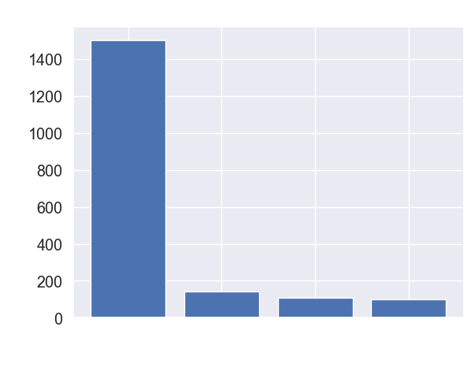
Plot Of Churn wrt Tenure
For accounts which churned, 81.28% of the churn occurred prior to completing 6 months of subscription. These notable observations apply only for the short duration (0 – 6 months) accounts:
A complaint was registered for 54.60% of these accounts.
66.47% of the account segment was regular plus.
79.63% used a coupon for payment at least once.
The median customer care contact was 17 times.
Churn
0 - 6
6 - 12
12 - 18
> 12
Tenure (Months)

Slide 11
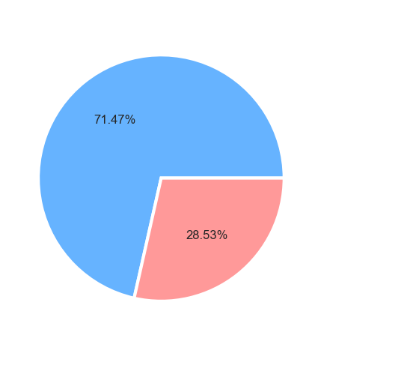
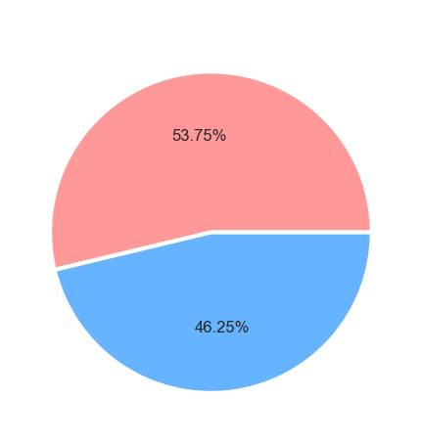
Customer Complaints In Last 12 Months wrt Churn
Overall Dataset
Accounts Which Churned
Complained in last 12 months
No complaints
Complained in last 12 months
No complaints
Accounts with a complaint in last 12 months are 2.91 times more likely to churn than accounts with no complaint.

Slide 12
Appendix

Slide 13
Modeling Process (Validation and Interpretation)
Split the dataset into train and test sets
Impute missing values
Add a calculated variable for average monthly cashback / revenue
Build different models - Logistic Regression, Decision Tree, Random Forest, Gradient Boost, and XG Boost using base dataset (imbalanced)
Calculate confusion matrix and plot feature importances
Calculate training and testing Accuracy, Recall, Precision, F1-Score
Compare all model performances on training and test data
Recall is the key evaluation metric due to the need to minimize churn.
Build corresponding models using oversampled data (balanced) and evaluate
Select a final model to be used.

Slide 14
Reasoning For Model Selection
The Tuned XGBoost model with base data was selected for these reasons:
Recall is the key metric as identifying all accounts liable to churn is key and Tuned XGBoost using base data was found to be superior:
Testing Recall - 0.8963
Testing Precision - 0.7834
Testing Accuracy - 0.9408
Testing F1 Score – 0.9294
Total false negative count of 59
Although the Testing Recall for the Tuned XGBoost using oversampled data was very slightly greater (0.8998), the Precision, Recall, and Accuracy are significantly lower and the reduction in false negative is only two to a value of 57.

Slide 15
Model Comparisons (Base Data and Hyperparameter Tuning)
 | Decision Tree | Random Forest | Gradient Boosting | Logistic Regression | XG Boosting
Training Accuracy | 0.8807 | 0.9958 | 0.9074 | 0.8859 | 0.9746
Training Recall | 0.7604 | 0.9894 | 0.5870 | 0.4695 | 0.9925
Training Precision | 0.6186 | 0.9857 | 0.8106 | 0.7616 | 0.8739
Training F1-Score | 0.6822 | 0.9876 | 0.6809 | 0.5809 | 0.9294
 | Decision Tree | Random Forest | Gradient Boosting | Logistic Regression | XG Boosting
Testing Accuracy | 0.8736 | 0.9532 | 0.9032 | 0.8840 | 0.9408
Testing Recall | 0.7188 | 0.8330 | 0.5589 | 0.4482 | 0.8963
Testing Precision | 0.6050 | 0.8827 | 0.8071 | 0.7658 | 0.7834
Testing F1-Score | 0.6570 | 0.8571 | 0.6604 | 0.5654 | 0.8361

Slide 16
Model Performance (Oversampled Data and Hyperparameter Tuning)
 | Decision Tree | Random Forest | Gradient Boosting | Logistic Regression | XG Boosting
Training Accuracy | 0.7754 | 0.9802 | 0.9177 | 0.8149 | 0.8843
Training Recall | 0.9195 | 0.9933 | 0.9031 | 0.8362 | 0.9919
Training Precision | 0.7138 | 0.9679 | 0.9302 | 0.8020 | 0.8162
Training F1-Score | 0.8037 | 0.9804 | 0.9165 | 0.8187 | 0.8955
 | Decision Tree | Random Forest | Gradient Boosting | Logistic Regression | XG Boosting
Testing Accuracy | 0.6841 | 0.9298 | 0.8937 | 0.7830 | 0.7886
Testing Recall | 0.8612 | 0.8489 | 0.6837 | 0.7821 | 0.8998
Testing Precision | 0.3315 | 0.7618 | 0.6849 | 0.4222 | 0.4380
Testing F1-Score | 0.4787 | 0.8030 | 0.6843 | 0.5484 | 0.5892

Slide 17
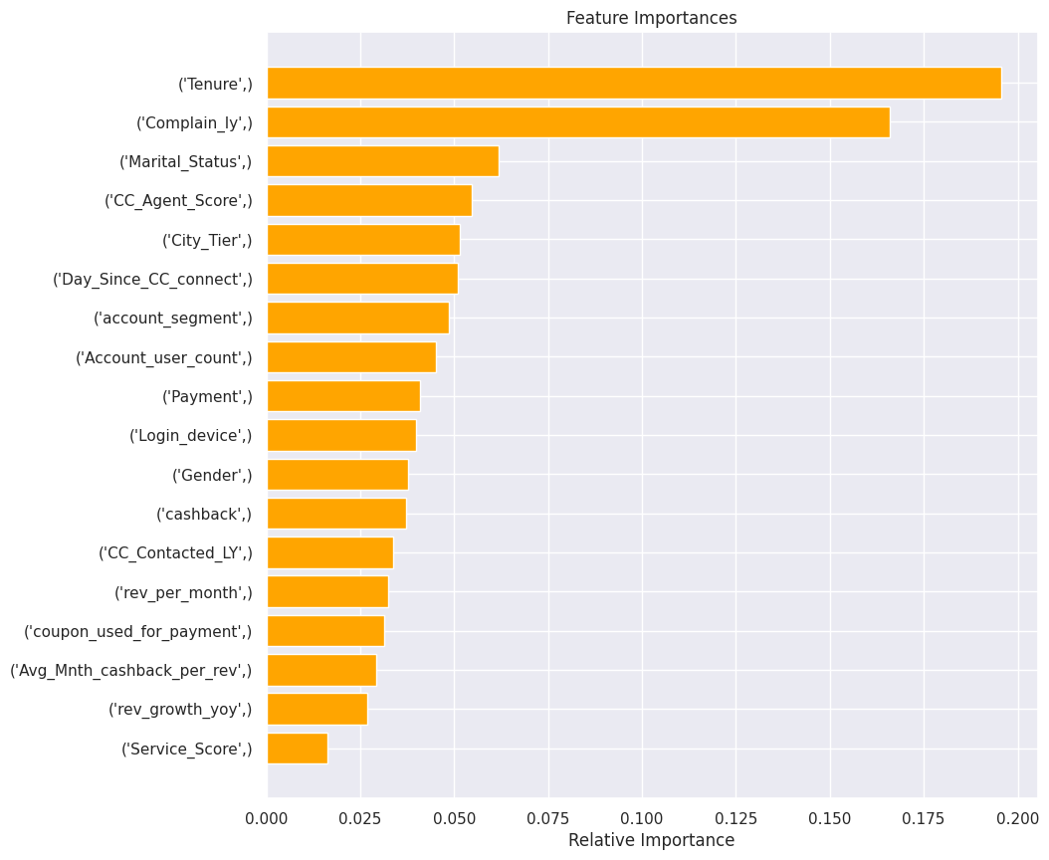
Interpretation From The Best Model
Recall is the key evaluation metric.
The superior model is XGBoost with hyperparameter tuning applied to the base data.
Testing Accuracy – 0.9408
Testing Recall – 0.8963
Testing Precision – 0.7834
Testing F1 Score – 0.8361
Tenure, Complain_ly, and Marital_Status are the three most important features.
Appendix includes additional modeling results.

Slide 18
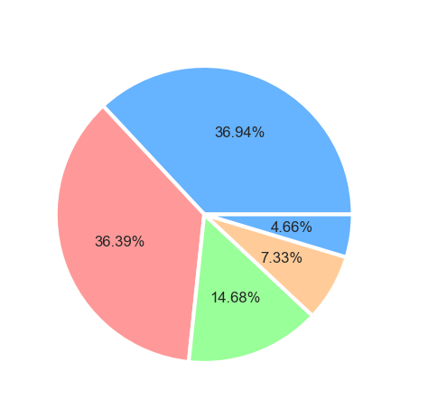
Account Segment Data
Account Segment Financial Impacts | Regular | Regular Plus | Super | Super Plus | HNI
% Monthly Income Contribution | 5.10 | 34.24 | 36.66 | 8.15 | 15.86
% YOY Revenue Growth Contribution | 4.34 | 37.19 | 36.28 | 7.39 | 14.72
Account Segment Population Distribution
Regular Plus
Super
Regular
Super Plus
HNI

Slide 19
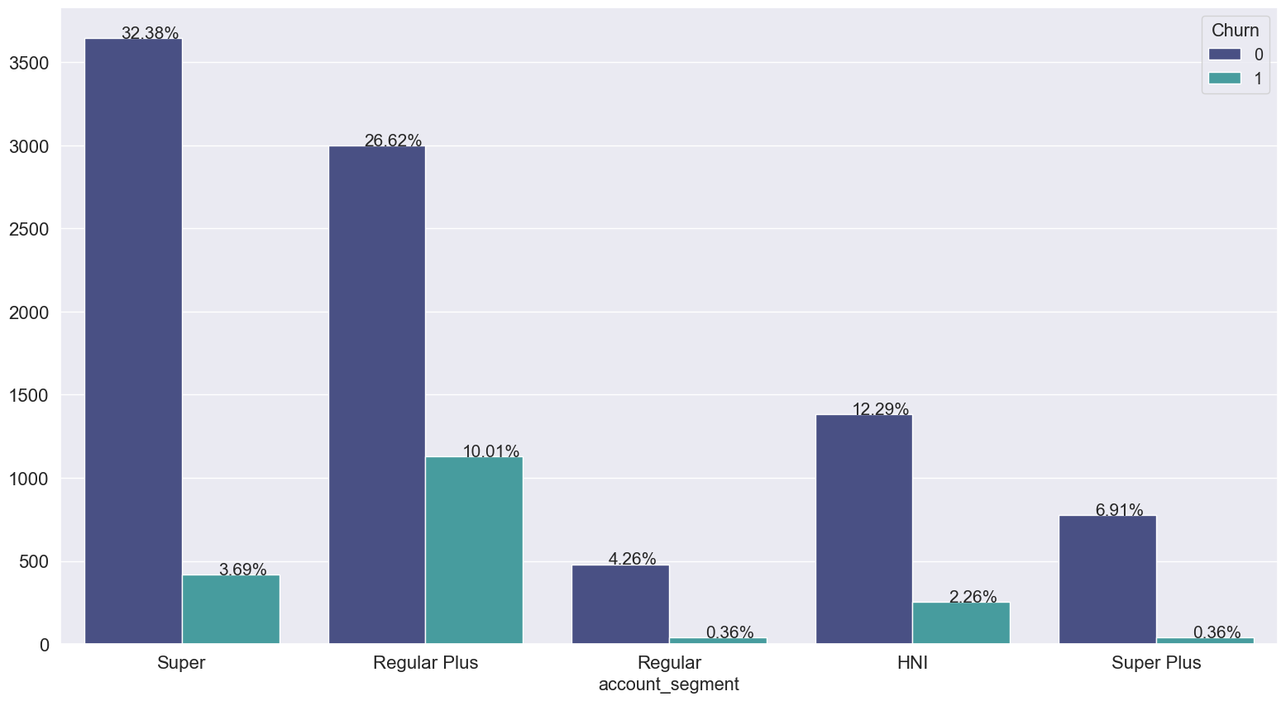
Relationship Between Churn and Account Segment
Super Plus - 4.95% churned
Regular - 7.79% churned
Super - 10.23% churned
HNI - 15.53% churned
Regular Plus – 27.33% churned

Slide 20
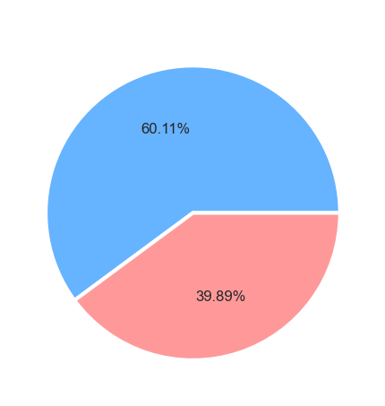
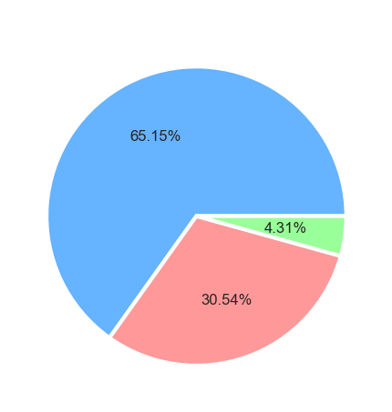
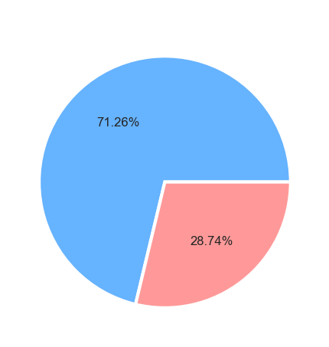
Gender, City Tier, and Login Device Demographics Charts
Gender
City Tier
Login Device
Male
Mobile
1.0
2.0
Female
3.0
Computer

Slide 21
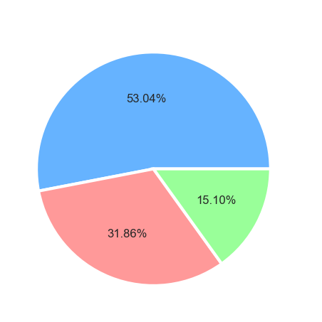
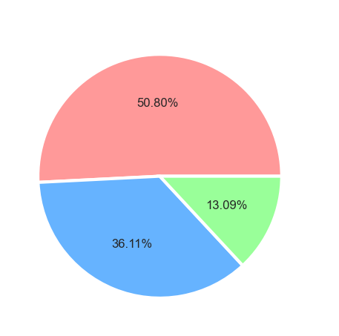
Account Primary Customer Marital Status wrt Churn
Overall Dataset
Accounts Which Churned
Married
Single
Divorced
Divorced
Single
Married
Accounts with a single status primary customer are 2.34 times more likely to churn than accounts with the primary account customer with married status.

Slide 22
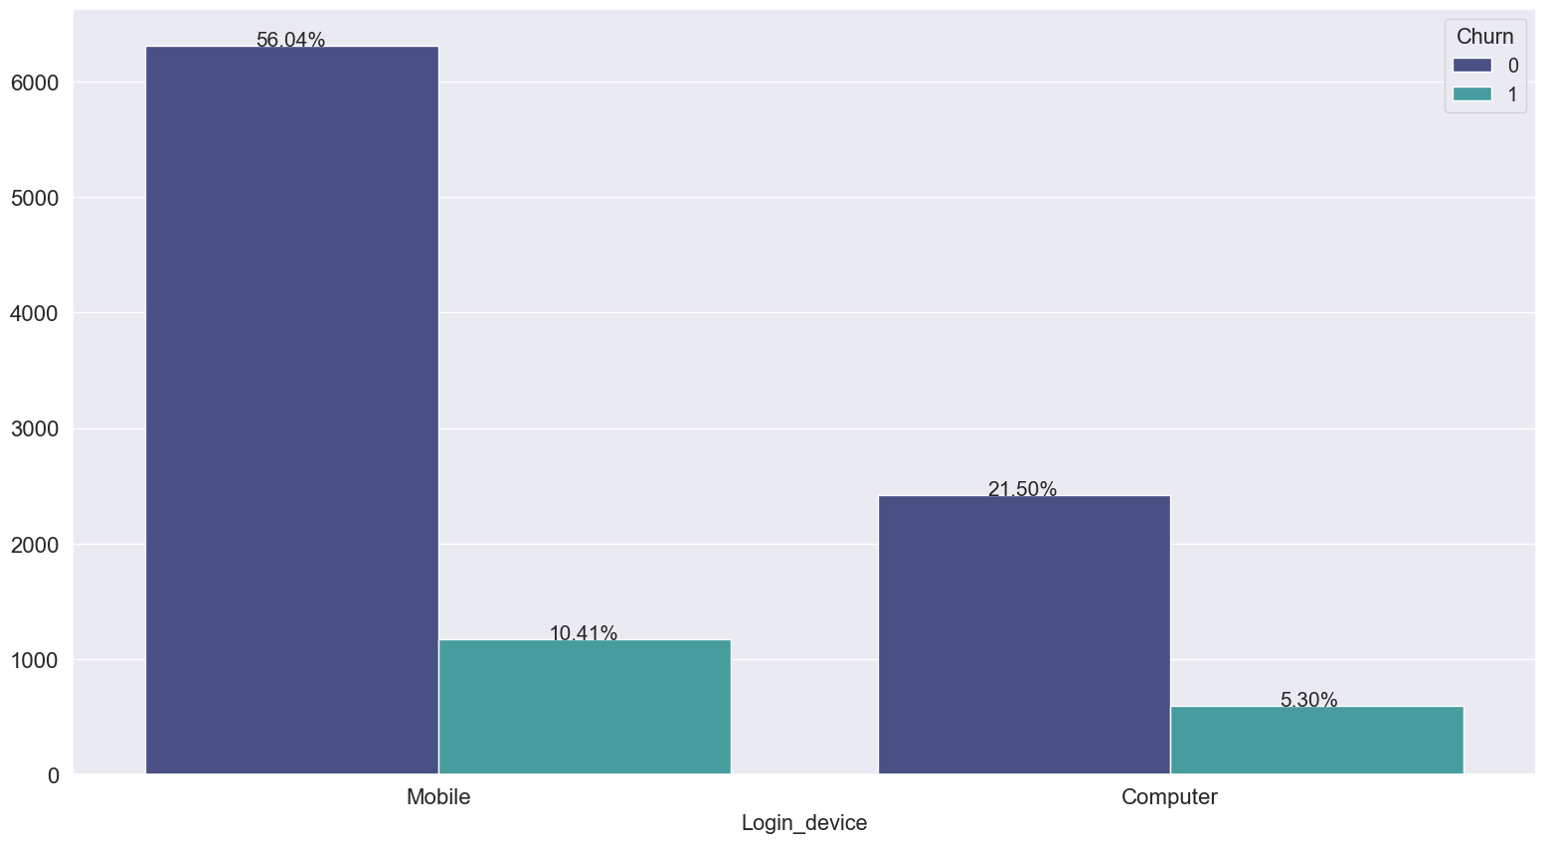
Relationship Between Churn and Login Device
Mobile Login – 15.67% churned
Computer Login – 19.78% churned

Slide 23
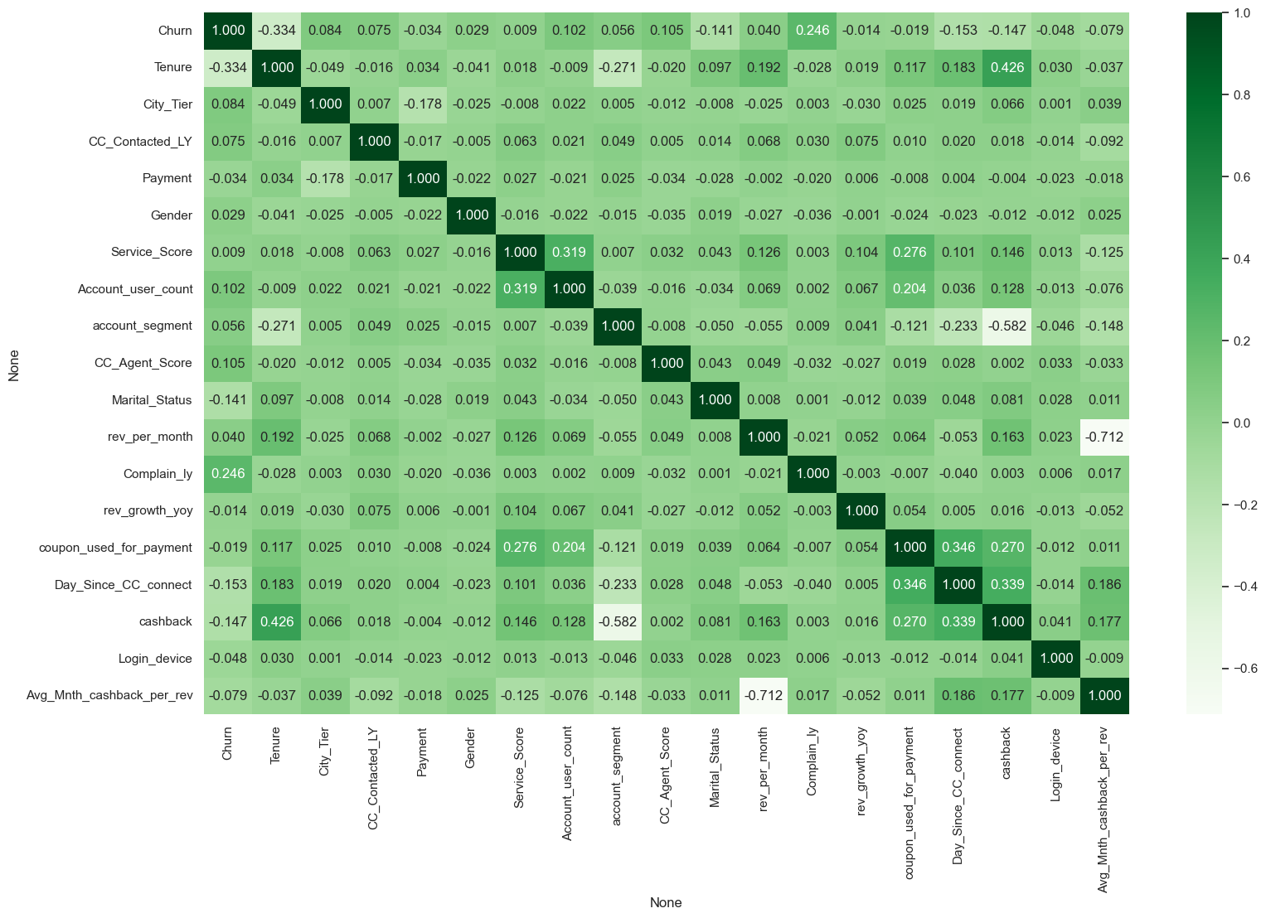
Correlation Plot
Churn is negatively correlated with tenure.
Churn is positively correlated with a complaint in the last year.
Tenure and cashback are positively correlated.
There is a strong negative correlation between monthly revenue and cashback amount per monthly revenue amount ratio.

Slide 24
Data Pre-Processing – Missing Variable Treatment
Variable Name | Unique Value Modifications | Total Values Imputed From NaN
Tenure | # changed to NaN | 218
City_Tier | Not Applicable | 112
CC_Contacted_LY | Not Applicable | 102
Payment | Not Applicable | 109
Gender | F and M changed to Female and Male | 108
Service_Score | Not Applicable | 98
Account_user_count | @ changed to NaN | 444
Account_segment | + changed to Plus | 97
CC_Agent_Score | Not Applicable | 116
Marital_Status | + changed to NaN | 212
rev_per_month | Not Applicable | 791
Complain_ly | Not Applicable | 357
Rev_growth_yoy | $ changed to NaN | 3
Coupon_used_for_payment | #, $, * all changed to NaN | 3
Day_Since_CC_connect | $ changed to NaN | 358
cashback | Not Applicable | 473
Login_device | &&&& changed to NaN | 760

Slide 25
Data Pre-Processing – Outlier Treatment
Variable Name | Count Of High Outliers Limited To 75% Quartile + 1.5 * IQR | Count Of Low Outliers Limited To 25% Quartile - 1.5 * IQR
Tenure | 139 Values > Right Whisker | Not Applicable
CC_Contacted_LY | 42 Values > Right Whisker | Not Applicable
Service_Score | 5 Values > Right Whisker | 8 Values < Left Whisker
rev_per_month | 185 Values > Right Whisker | Not Applicable
Coupon_used_for_payment | 1380 Values > Right Whisker | Not Applicable
Day_Since_CC_connect | 33 Values > Right Whisker | Not Applicable
cashback | 859 Values > Right Whisker | Not Applicable

